Slide 1
Chapter 2
The Microprocessor and its Architecture
The Intel 8086, 80X86, and Pentium Family

Slide 2
Objectives for this Chapter
Describe the function and purpose of program-visible registers
Describe the Flags register and the purpose of flag bits
Describe how memory is accessed using segmentation in both the real mode and the protected mode

Slide 3
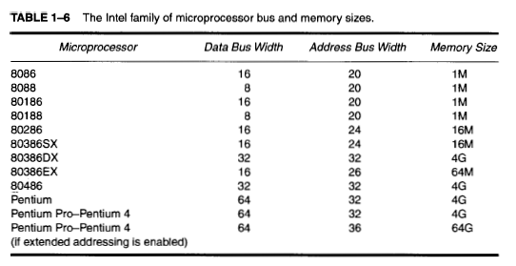
The Intel Family
Addressable
Memory, bytes
= 2^{A}
(A)
← (1978)
Microcontrollers)
← (2000)
≈ I n c r e a s e
I n c r e a s e

Slide 4
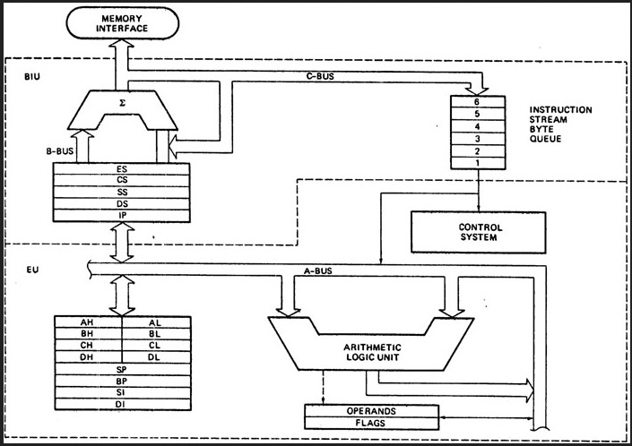
8086 internal architecture

Slide 5
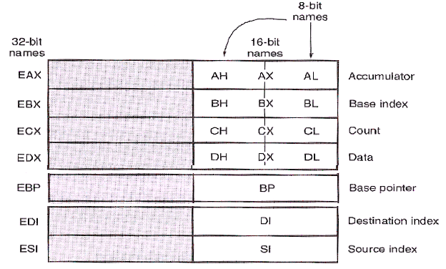
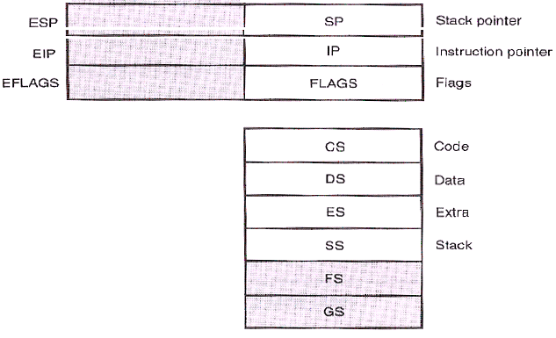

Programming
Model
General Purpose
Registers
Special Purpose
Registers
Segment
Registers
80386 and above:
32-bit registers (except seg. regs.)
Two additional segment registers:F,G

Slide 6
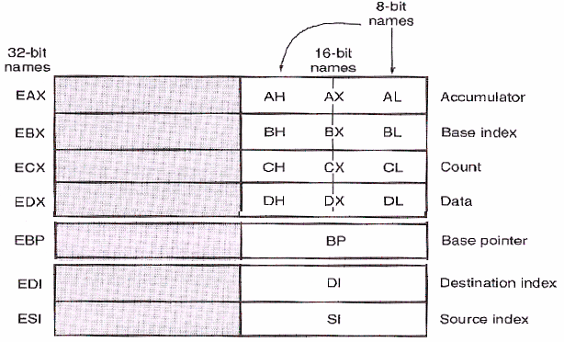
General-Purpose Registers
The top portion of the programming model contains the general purpose registers: EAX, EBX, ECX, EDX, EBP, ESI, and EDI
Can carry both Data & Address offsets
Although general in nature, each has a special purpose and name:
EAX – Accumulator
Used also as AX (16 bit), AH (8 bit), and AL (8 bit)
EBX – Base Index often used to address memory (BX, BH, and BL)

Slide 7
General-Purpose Registers (continued)
ECX – count, for shifts, rotates, and loops (CX, CH, and CL)
EDX – data, used with multiply and divide (DX, DH, and DL)
EBP – base pointer used to address stack data (BP)
ESI – source index (SI) for memory locations, e.g. with string instructions
EDI – destination index (DI) for memory locations

Slide 8
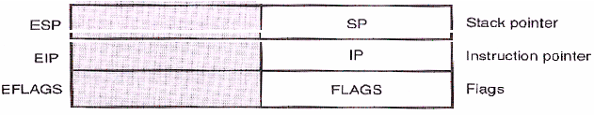
Special-Purpose Registers
ESP, EIP, and EFLAGS
Each has a specific task
  ESP – Stack pointer: Offset to the top of the stack in the stack segment. Used with procedure calls (SP)
  EIP – Instruction Pointer: Offset to the next instruction in a program in the code segment (IP)
  EFLAGS – indicates latest conditions (state) of the microprocessor (FLAGS)
Used With
SS
CS

Slide 9
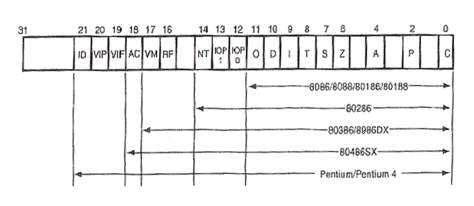
EFLAGS
80386DX

Slide 10
The Flags
Determined by last operation
Basic Flag Bits (8086 etc.): Output, Input bits
C – Carry/borrow from last operation
P – the parity flag (little used today)
A – auxiliary flag Half-carry between bits 3 and 4,
used with BCD arithmetic
Z – zero
S – sign
O – Overflow
D – direction - Determines auto increment/decrement direction for SI and DI registers with string instructions
I – interrupt - Enables (using STI) or disables (using CLI) the processing of hardware interrupts arriving at the INTR input pin of the processor
T – Trap - Turns trapping interrupt (for program debugging) on/off
Set/Reset explicitly by the programmer
Some flag bits can be both,
e.g. the C flag

Slide 11
Newer Flag Bits
IOPL – 2-bit I/O privilege level in protected mode
NT – nested task
RF – resume flag (used with debugging)
VM – virtual mode: multiple DOS programs each with a 1 MB memory partition in Windows
AC – alignment check: detects addressing memory on wrong boundary for words/double words
VIF – virtual interrupt flag
VIP – virtual interrupt pending
ID = CPUID instruction is supported
    The instruction gives info on CPU version and manufacturer

Slide 12
Segment Registers
Each register points to the start of a segment in memory
The segment registers are:
  CS (code),
  DS (data),
  ES (extra data. used as destination for some string instructions),
  SS (stack),
  FS, and GS: Additional segment registers on 80386 and above
Segment registers define the start of a section (segment) of memory for a program.
A segment is either:
- 64K (2¹⁶) bytes of fixed length (real mode), or
- Up to 4G (2³²) bytes of variable length (protected mode).
All code (programs) reside in a code segment.

Slide 13
Real Mode Memory Addressing
Used by the DOS operating system
The only mode available on the 8086-8088:
20 bit address bus → 1 MB, 16 bit data bus, 16 bit registers
Real mode memory is the first 1M (2²⁰) bytes of the memory system (real, conventional, DOS memory) in later processors
Real mode 20-bit addresses are obtained by combining a segment number (in a segment register) and an offset address (in another processor register)
The segment register address (16-bits) is appended with a 0H or 0000₂ (or multiplied by 10H or 16d) to form a 20-bit start of segment address
Then the effective memory address (EA) =
this 20-bit segment start address + the 16-bit offset address in another processor register
For the 8086, segment length is fixed @ 2¹⁶ = 64K bytes (determined by the size of the offset registers)

Slide 14
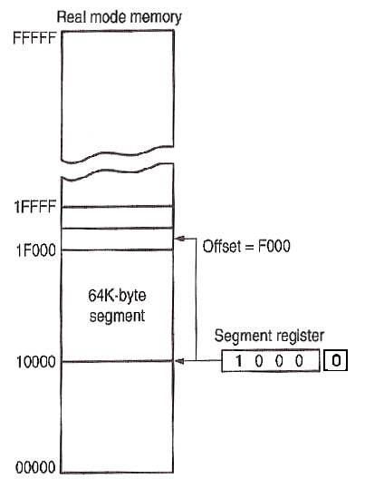
1 MB
(1 MB)
EA (Effective Address) of byte accessed
20-bit (5-byte)
Physical
Memory address
64 KB
Segment
+
16-bit each
Appended 4 bits (0H)
Segment number
In Segment Register

Slide 15
Effective Address Calculations
EA = segment register (SR) x 10H + offset
(a) SR: 1000H
10000 + 0023 = 10023
(b) SR: AAF0H
AAF00 + 0134 = AB034
(c) SR: 1200H
12000 + FFF0 = 21FF0
Q: Is 3FC81 a valid start address of a segment?

Slide 16
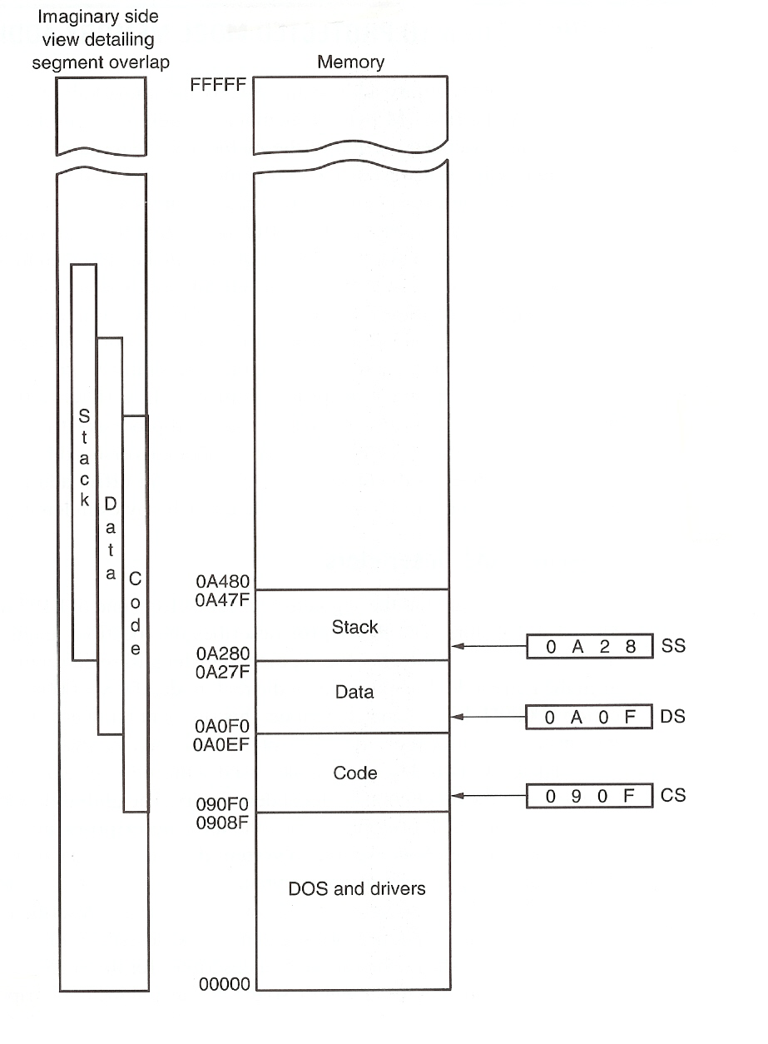
Overlapping segments
How to detect overlap?
Top of CS:
090F0
FFFF+
190EF
Code should be limited to only
this portion of the code
segment, to avoid
effects of segment overlap

Slide 17
Defaults
Convention Example: EA = CS:[IP]
Default segment numbers in:
  CS for program (code)
  SS for stack
  DS for data
  ES for string (destination) data
Default offset addresses that go with them:
Segment number
in Segment register
Offset: Literal
or in a CPU register
Segment | Offset (16-bit) 8080, 8086, 80286 | Offset (32-bit) 80386 and above | Purpose
CS | IP | EIP | Program
SS | SP, BP | ESP, EBP | Stack
DS | BX, DI, SI, 8-bit or 16-bit # | EBX, EDI, ESI, EAX ECX, EDX, 8-bit or 32-bit # | Data
ES | DI, with string instructions | EDI, with string instructions | String destination

Slide 18
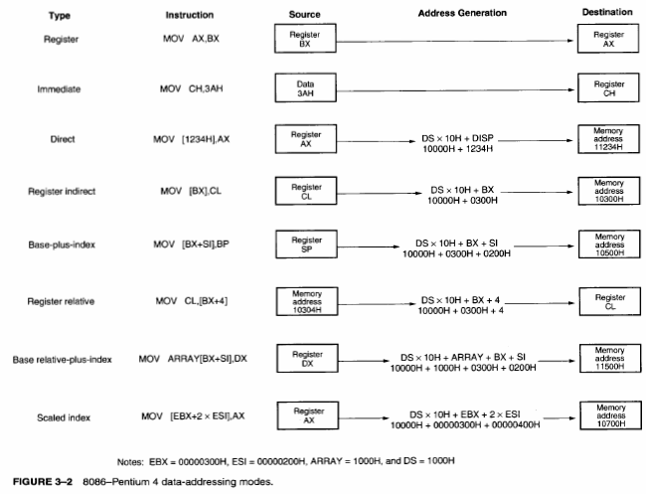
Addressing Modes Summary

Slide 19
Segmentation: Pros and Cons
Advantages:
Allows easy and efficient relocation of code and data
To relocate code or data, only the number in the relevant segment register needs to be changed
Consequences:
→A program can be located anywhere in memory without making any changes to it (addresses are not absolute, but offsets relative to start of segments)
→Program writer needs not worry about actual memory structure (map) of the computer used to execute it
Disadvantages:
Complex hardware and for address generation
Address computation delay for every memory access
Software limitation: Program size limited by segment size (64KB with the 8086)

Slide 20
Limitations of the above real mode segmentation scheme
Segment size is fixed at and limited to 64 KB
Segment can not begin at an arbitrary memory address…
With 20-bit memory addressing, can only begin at addresses starting with 0H, i.e. at 16 byte intervals
→ Principle is difficult to apply with 80286 and above, with segment registers remaining at 16-bits!
80286 and above use 24, 32 bit addresses but still 16-bit segment registers
No protection mechanisms: Programs can overwrite operating system code segments and corrupt them!
→ Use memory segmentation in the protected mode
Append: 00H 0000H

Slide 21
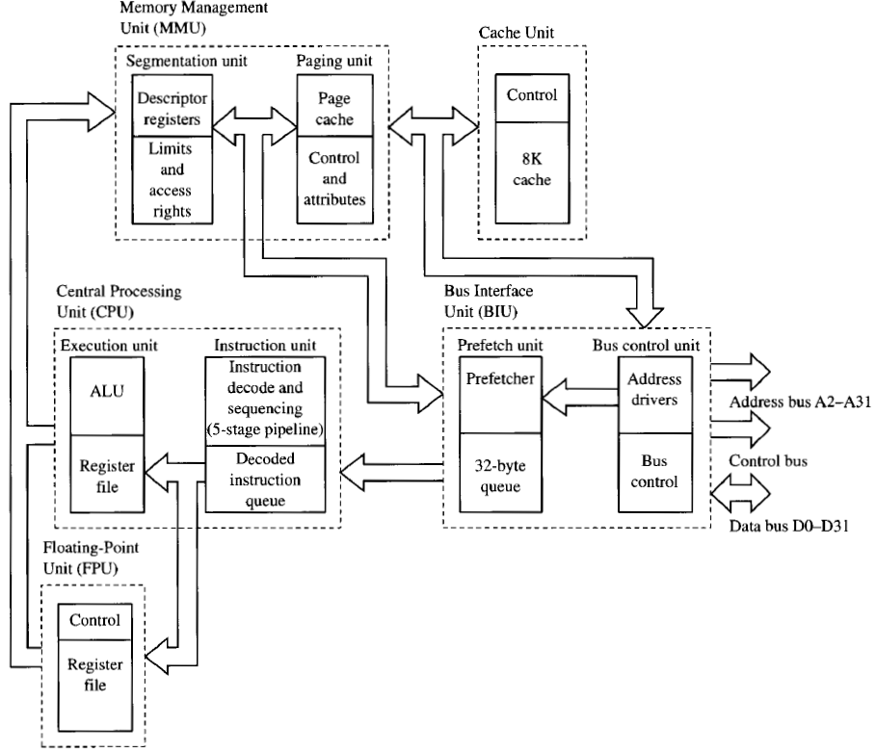
Main
Memory
Super pipelining
EU
On Chip
Example: 486 Processor Model
Colored units are new additions
Example: 486 Processor Model

